Slide 1
Project: Predicting Movie Popularity
Laura Hoffmann
Bilal Kudaimi
Erez Sarousi

Slide 2
Introduction/Problem Background
Hollywood is worth over forty-two billion dollars as of 2019.
Roughly 13,500 people are actors.
Hollywood employees just under a million people.
Due to the commercial profitability of Hollywood, it becomes important to provide quality movies.
The question of this assignment is, “Can predictive analytics predict the next blockbuster hit to increase profits?”

Slide 3
Solution
Yes it can! Predictive analytics can predict the next blockbuster hit using machine learning models. The goal of this project was to build one such model using the Python programming language.
A machine learning model is a program that draws relationships from historical data to output predictions about new data.
This model was able to predict the IMDb score of new movies using information from previously released movies, such as directors, actors, budget, box office, etc.
Directors can use the model to increase their profits by shifting focus to the movies predicted to succeed.

Slide 4
Analysis
Our analysis was split into three parts:
1. Importing the data and preparing it for the model.
2. Conducting exploratory data analysis (EDA) to gain insight
3. Building the model and evaluating its performance using RMSE.
What is RMSE? Root Mean Squared Error (RMSE) is a numerical value used to evaluate how well some machine learning models perform.
RMSE is essentially a measure of how inaccurate a model is. The closer it is to 0, the more accurate the model is.

Slide 5
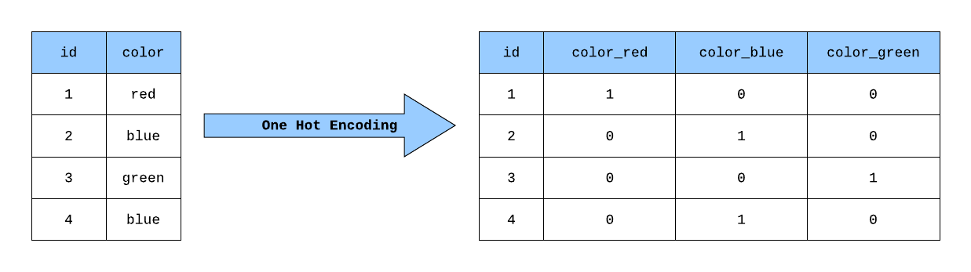
Part 1: Data Preparation
The machine learning model can’t draw relationships from the data as it is, so we need to “prepare” it.
Without preparing the data, the model might output a very high RMSE value.
We used the R programming language for this part, as it made data preparation faster.
To accomplish this preparation, we did four things to our starting dataset:
We replaced missing data with median data.
We removed any strange characters such as Å.
We removed duplicate movie entries.
We performed what is called one-hot encoding to avoid over or under-representing data (see below figure for one-hot encoding example).

Slide 6
Part 2: Exploratory Data Analysis (EDA)
EDA is the act of generating visualizations from the data to gain insight.
This includes reducing the number of features to improve accuracy
Our EDA consisted of a few steps:
We dropped any movie information that correlated highly to other movie information within the dataset.
Histograms were generated for all variables to find the data range
The following plots were generated:
Scatter plots of IMDb score versus movie budget and Facebook likes
A chart of the 10 highest scoring directors and their scores

Slide 7
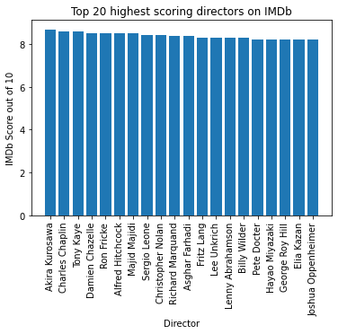
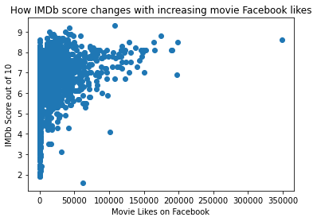
Selected Visualizations
Left: Top 20 highest scoring directors and their IMDb scores
Right: IMDb score versus movie Facebook likes

Slide 8
Part 3: Model Building and Evaluation
With the data prepared and analyzed, the machine learning model - the meat of the project - was constructed to predict IMDb scores from input movie information.
The data was split into two sections: One for building our model (letting it draw relationships from the data), and one for evaluating our model (letting it predict the IMDb score for those movies and seeing how close the predicted scores were to the true scores).
We chose ridge regression to build our method because this was the best method for our dataset. We built four variants of the model in an attempt to reduce RMSE values.
Two with different methods of splitting the data, and two without one-hot encoded features (see the table on the next slide).

Slide 9
Summary of Results
Four models were built and tested, and the following is a table summarizing the RMSE for each of the models.
The lowest RMSE is 0.69, obtained by Model 1. The values were all very close to 0, meaning our model is fairly accurate at predicting movie IMDb scores.
Model | One-hot encoded features? | 10-fold cross-validation? | Train_test_split used? | RMSE
1 | NO | YES | NO | 0.69
2 | NO | NO | YES | 0.82
3 | YES | YES | NO | 0.87
4 | YES | NO | YES | 0.93

Slide 10
Issues/Challenges Encountered During the Work
Recognizing the best steps to take for each issue while cleaning the data
Special characters were removed from the title column
Whitespaces were trimmed from each of the character columns
All NA values in numerical columns were filled with column means and duplicated rows were removed
Originally several genres were listed for each movie in the data set
Figure out the best way to have all of the genres for each movie listed separately
Each type of genre was made into its own column and the movie rows were given 0s or 1s for that column

Slide 11
Conclusions
We have determined that the combination that would output the best movie (in that, it would result in the highest IMDB score):
Is between 150 to 200 minutes long.
Is rated G or R.
Is directed by Marc Forster.
Has Leonardo DiCaprio as Actor 1 and Rory Kinnear as Actor 3 - both of whom have higher likes on Facebook.
Made in the UK or France.
Is not a comedy.

Slide 12
Future Work Required
There is future work that could build upon this predictive model. One such example is that many studios have a budget. If we had further data, such as average movie cost per actor, we could find the top IMDb score with those constraints.
Furthermore, if this work was done in conjunction with a site such as Rotten Tomatoes, sentiment analysis could be used on reviews to understand feelings towards certain film elements.

Slide 13
Overall Team Contributions
The following table outlines the contributions made by each team member:
Team Member | Task Contributions
Laura Hoffmann | Evaluated issues encountered in the coding, debugging the EDA and developing the model.
Bilal Kudaimi | Generated a problem solution, performed EDA/made graphs, and edited the model.
Erez Sarousi | Created the ridge regression model, estimated the accuracy of the model, and conducted hyperparameter tuning.

Slide 14
Acknowledgements
We would like to thank the following people for their continued enthusiasm and support during this MSDS program:
Professor Fadi Alsaleem
All of our DSC 630 classmates

Slide 15
References
Brown, Z. (2016). How many films are produced each year? Quora. https://www.quora.com/How-many-films-are-produced-each-year.
Gleeson, P. P. D. (2018, June 27). Statistics on People Getting Famous in Acting. Work - Chron.Com. https://work.chron.com/statistics-people-getting-famous-acting-23946.html
Odegua, R. (2020) How to put machine learning models into production. Stack Overflow Blog. https://stackoverflow.blog/2020/10/12/how-to-put-machine-learning-models-into-production/.
Pittet, S. (2021). Continuous integration vs continuous delivery vs continuous deployment. Atlassian. https://www.atlassian.com/continuous-delivery/principles/continuous-integration-vs-delivery-vs-deployment.
Sakoui, A. (2019, March 18). Hollywood Employs More Workers Than Mining and Farming, MPAA Says. Bloomberg. https://www.bloomberg.com/news/articles/2019-03-18/hollywood-tops-mining-crop-production-in-employment-mpaa-says
Watson, A. (2020, November 10). Film Industry - statistics & facts. Statista. https://www.statista.com/topics/964/film/

